Slide 1



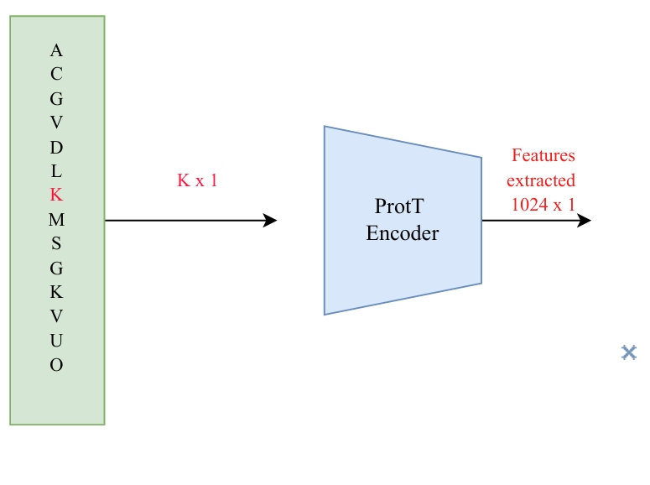
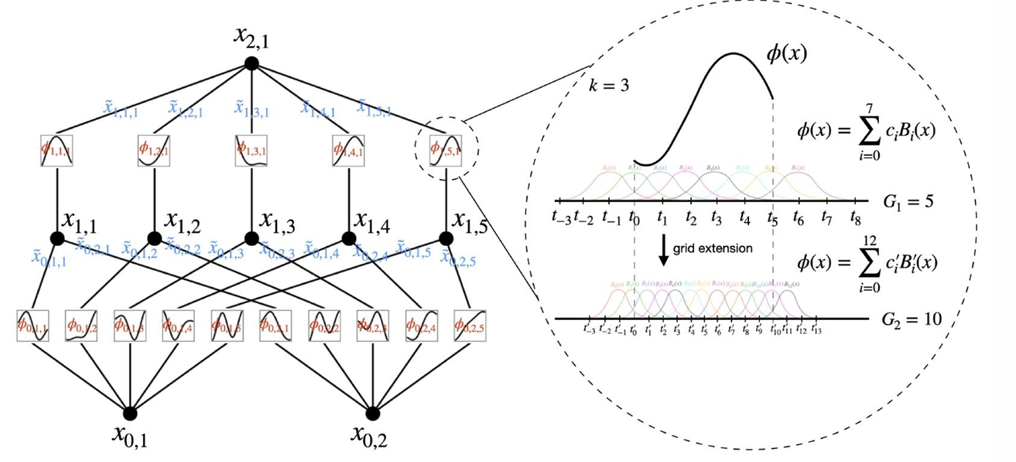
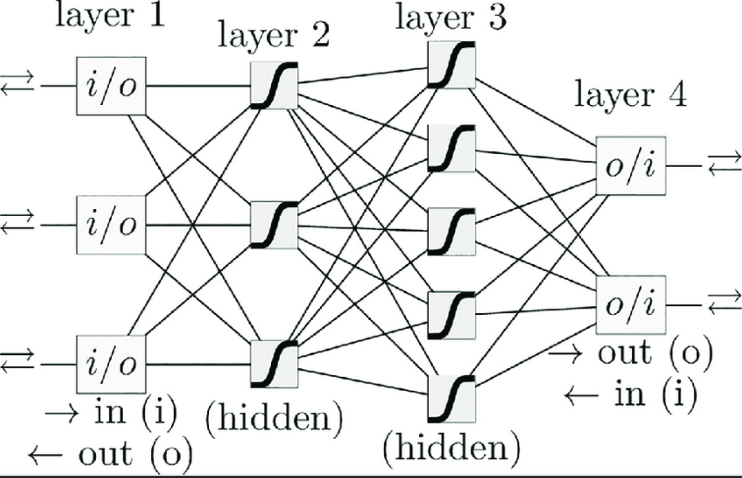
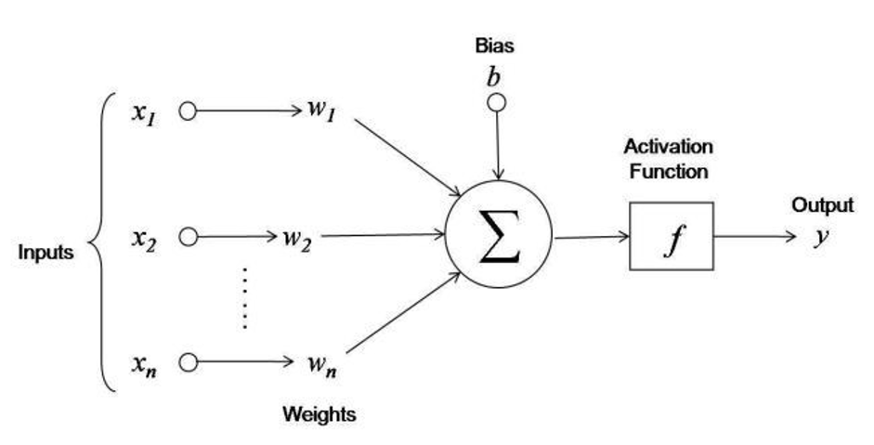
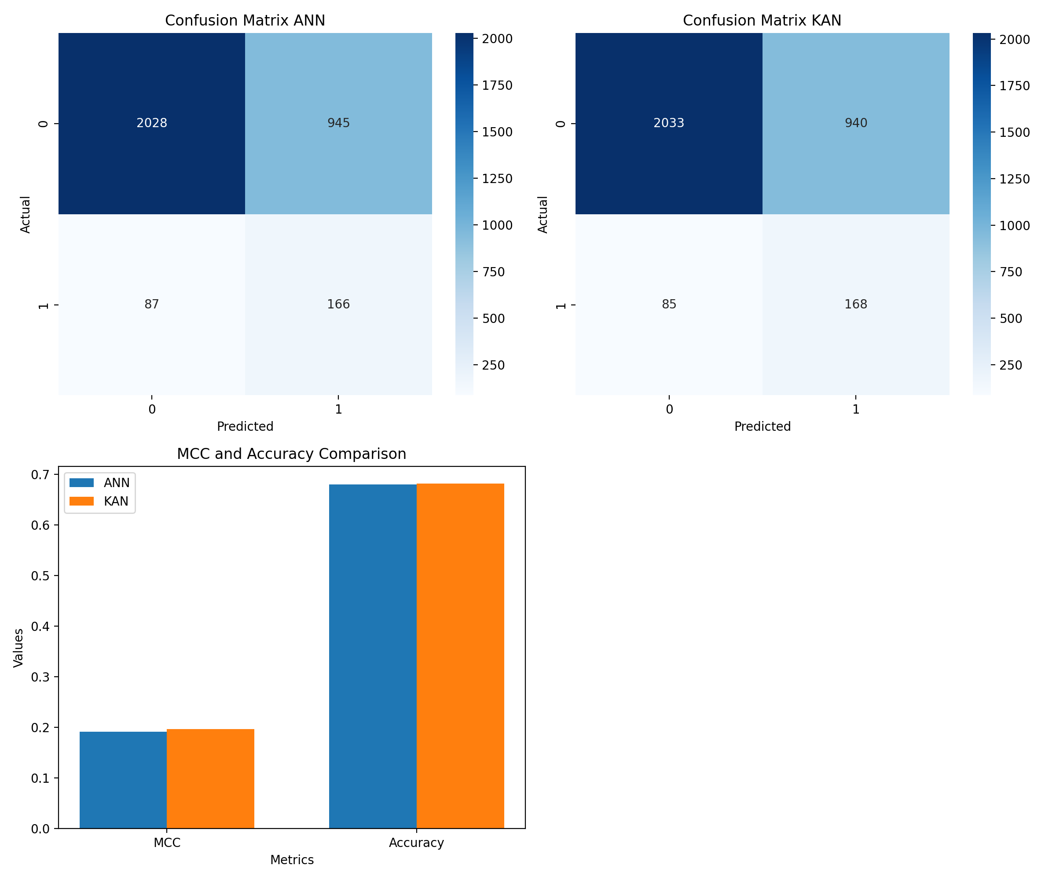
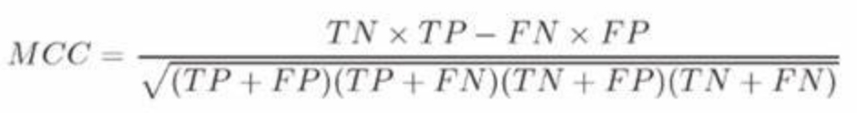
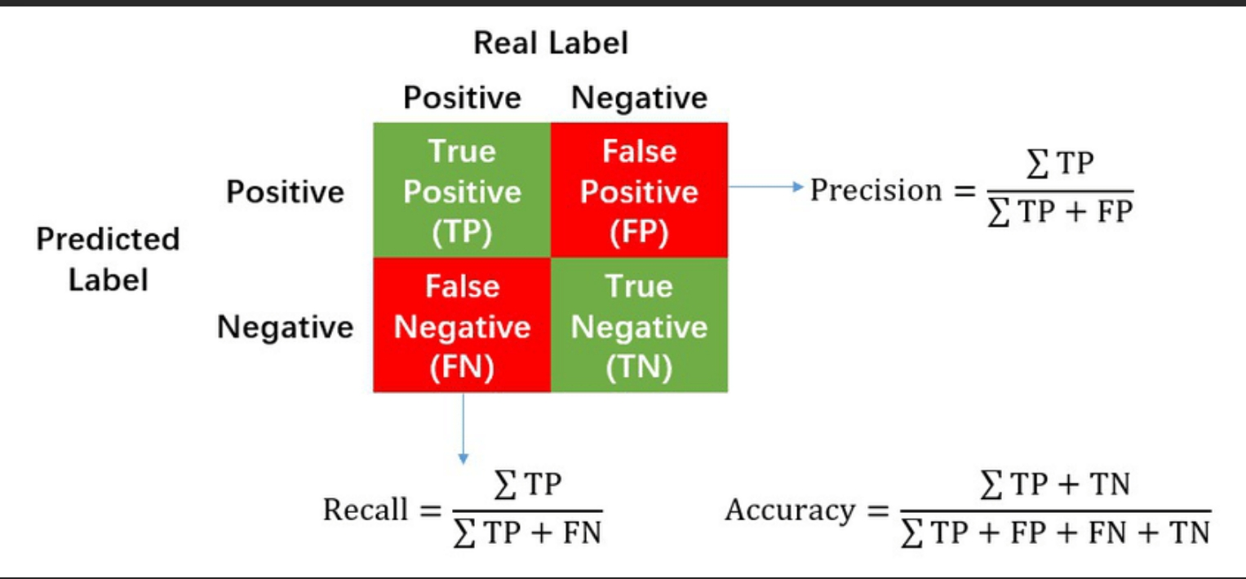
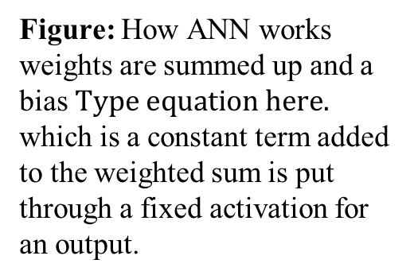
Comparing Protein Artificial Neural Network and Kolmogorov – Arnold Networks(KAN) for protein Succinylation site prediction
Isaac Sutka and KC Lab
253, 1024
Michigan Technological University, Houghton, MI. 49931, USA
Abstract
Methods
KAN vs ANN Model Architecture
Protein succinylation is a critical post-translational modification (PTM). This modification plays a significant role in crucial regulatory mechanism that contributes to the dynamic control of cellular functions and the maintenance of cellular health.
In this work, a protein language model called ProtT5 is used to extract features which are unique identifiers of the protein sequences for protein succinylation site prediction. Subsequently, the classification performance of training Artificial Neural network (ANN) and Kolmogorov- Arnold Network (KAN) are compared. KAN is a newly developed algorithm which is considered to have better interpretability as compared to the traditional ANN.
LMSuccSite (sequences) train and test data which was obtained from KC Lab was sent through ProtT5 which extracted 1024 features for the site of interest which was sent into a KAN model to predict the if there is succinylation in the sites or not if its positive or negative and the same data was sent through an ANN model.
Kolmogorov-Arnold Network(KAN)
Figure: KAN has learnable activation functions placed on the edges (connections) between nodes. This allows each connection to adaptively adjust its activation function based on the input data.
Data Set
The training set consists of 4749 positive sites and 4750 negative sites
The test set consists of 253 positive and 2973 negative site.
Figure: How ANN works weights are summed up and a bias which is a constant term added to the weighted sum is put through a fixed activation for an output.
Figure : sequence with Succinylation sites from KC lab being sent to the ProtT5 encoder.
Figure: All nodes share the same activation function in the ANN network.
Artificial Neural-Network(ANN)
Hypothesis
Results and Discussion
Conclusion
A Kolmogorov-Arnold Network will outperform predictive accuracy and MCC(Matthews Correlation Coefficient) for succinylation PTMs compared to a traditional ANN.
The performance of KAN and the traditional ANN models were very similar in this experiment, but KAN still performed better than ANN However, due to the nature of the experiment, these results require further testing. The original experiment on
succinylation involved more complex architectures, such as a 2D CNN(Convolution Neural Network) embedding model along with an ANN model.
Kan slightly outperforms the ANN model in terms of Accuracy by ~0.002%
MCC by ~0.0056%
KAN preforms better even though the data is same.
Background
Future directions
Figure: wavelet KAN was used which is a variant of KAN.
Figure: The measurement MCC is used to measure the quality of data this is the formula for calculating the MCC.
KAN's adaptive activation functions, where every weight parameter in the network is replaced by a multivariable functions of the input, which in theory may allow for more flexible and accurate modeling of complex data patterns. In contrast, the activation functions in traditional ANNs are fixed and associated with the nodes, which are the fundamental units in a neural network that process input data and transmit information to other nodes. These fixed functions on ANN dynamically determine neuron firing conditions based on the input data.
As the volume of biological data grows because of the advancement of technology, existing models will need to handle the increased complexity and variability. Improved predictive models can help in faster development of medical treatments and interventions. Also, PTM prediction can significantly reduce experimental costs and time in biological research, making the scientific process more efficient and effective. Future studies should involve further testing with the KAN on more sophisticated architectures to gain deeper insights and potentially more accurate results.
Figure: These results were running 10 epochs Kan MCC was 0.1969 while the accuracy was 0.682 with a confusion matrix of [[2033 940] [85 165]]I n comparison, the ANN models MCC was 0.1913 with an Accuracy of 0.680 and the confusion matrix for ANN was [[2042 931] [77 176]]
Figure :This is the Confusion matrix formula.
References and Acknowledgments
Contact
Lai, M.-J., & Shen, Z. (2023). The Kolmogorov Superposition Theorem can break the curse of dimension when approximating high dimensional functions.
Liu, Z., Wang, Y., Vaidya, S., Ruehle, F., Halverson, J., Soljačić, M., Hou, T. Y., & Tegmark, M. (2024). Kolmogorov-Arnold Networks (KANs). arXiv. https://doi.org/10.48550/arXiv.2404.19756
Umar Jamil https://github.com/hkproj/kan-
Pokharel, S., Pratyush, P., Heinzinger, M., Newman, R. H., & KC, D. B. (2024). Improving protein succinylation sites prediction using embeddings from protein language model. Journal/Conference Name. Thank you to Michigan Tech Department of Computing, along with the KC Lab members Dr. Dukka, Suresh Pokharel, Pawel Pratyush, Steven Garrett, Pukar Baral, Kepha Barsa, and Soufia Bahmani., Mohamed Sahidu ,Callen Carrier
KC-LAB, Department of Computer Science, College of Computing, MTU Imsutka@gmail.com
\

